Slide 1
SMART INDIA HACKATHON 2k19
Problem statement : Drone based medical facility
Category : Hardware
Technology bucket : robotics and drones
Organization : mindtree
Team name : Hyderabad Hawks
Team leader name : Bobde Preethi
college code : 1-3513469386
Problem statement id : LB6

Slide 2
Why the medical drone?
PROBLEM STATEMENT:
A Drone based medical facility for the rural areas as many rural areas in India are not able to access the medical help(includes blood and its derivatives) easily.
Drones help in transporting the medical supplies to remote hospitals located at inaccessible areas. For example, in situations where a hospital needs a specific category of blood for emergency treatment, delivery of such treatment material using drone facility for transportation avoids time delays. However, while designing such drones the following factors should be considered.
a) Payload of the copter.
b) Safe packing (mechanical or thermal) of the material should be ensured while the treatment material is loaded at the source. It implies that medicines or blood should be securely placed during transport or during delivery time. Enough shock protection should be provided if the material contains glass items (for example, injection vials)
c) Shock free delivery of the material at the destinations is a must.
d) Avoidance of collisions during transit.
e) Endurance of the copter. After delivering the material, drone has to return back to the launching place.
f) Balancing of the copter for vertical take-off and landing.

Slide 3
SOLUTION:
While Considering the payload, the motor and propeller characteristics (Number of motors used) should be identified along with the operating voltage and currents for given payload.
Drones are aerial units hence there is no time delay and the path are very clear.
The container is a thermoelectric module and is provided with a digital lock system.
Due to some extraneous factors the copter may land at an unfriendly location with in the hospital compound. In such situations the landing speed of the copter should be drastically reduced for smooth and safe landing.
The capacity of the battery should be so chosen that it can meet all power requirements till it is returns back to launching place. A safe thumb rule is that the copter should still have 30 percent charge after executing the RTL mode.
WORKING:
Hospitals in need of medications request the nearest central drone station
The medication is placed inside a cold container
The drone then flies to the rural area .
The hospital workers are notified to grab the delivery.
They type the digital passcode, open the container and collect the medications
TECHNOLOGY:
It uses DRONE WAYPOINT GPS NAVIGATION.
Raspberry pie (digital lock)
Mission planner software

Slide 4
Drones help in transporting the medical supplies to remote hospitals located at inaccessible areas. For example, in situations where a hospital needs a specific category of blood for emergency treatment, delivery of such treatment material using drone facility for transportation avoids time delays.
PROTOTYPE::
This is the prototype for the practical Drone. The following components are used in the prototype Drone construction
S.NO | COMPONENT | TYPE
1 | Type of the copter | Hexa copter
2 | Controller | Pixhawk-2.4.8
3 | Navigator | Ublox Neo M8N GPS
4 | Firmware | Mission planner
5 | Motors | 935kV
6 | Battery | 12V
7 | Electronic Speed controllers(ESC) | 30A
The container is THERMOELECTRIC MODULE. It consists of following components.
S.NO | COMPONENT
1 | Heat sink with a fan
2 | Peltier Module
3 | Simple heat sink
4 | Small CPU fan
5 | Digital lock

Slide 5
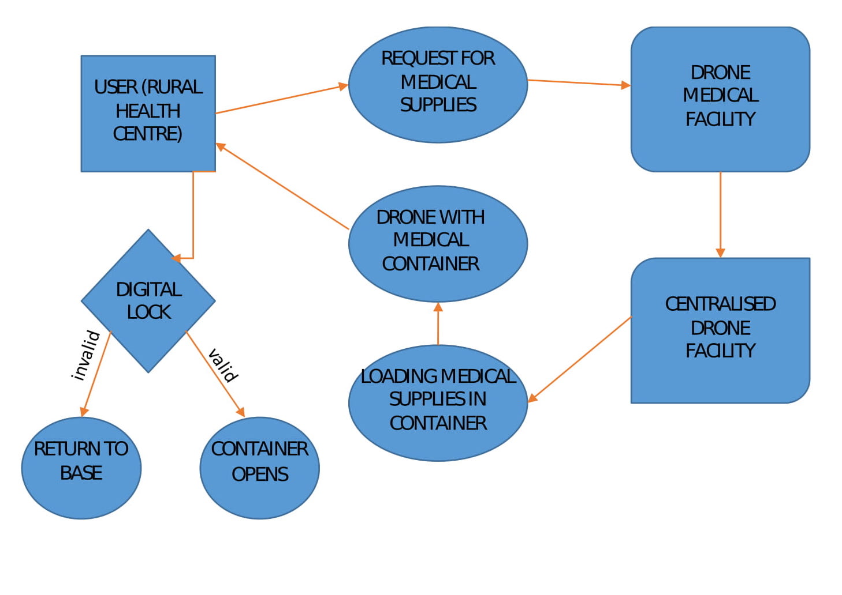
FRAMEWORK:
CONCLUSION:
The usage of Drone in transport of medical supplies to the rural area hospital has many advantages over the present problems faced by the regular procedure of transport of medical supplies to the hospitals.
It is way faster and efficient than the regular method. It is safe and secured as it provided with the digital lock system.
Upgrading the components used in the drone improves the efficiency and working of the Drone.

